Slide 1
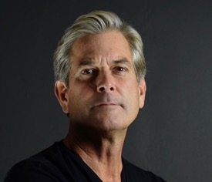
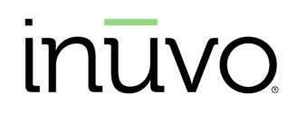
OCTOBER 2025 | LD MICRO
NYSE: INUV
PRESENTING TODAY:
Rob Buchner
Chief Operating Officer
ROB.BUCHNER@INUVO.COM

Slide 2

OCTOBER 2025 | LD MICRO
PREDICTIVE AI
AUDIENCE DISCOVERY
& MEDIA ACTIVATION
NYSE: INUV

Slide 3
SAFE HARBOR STATEMENT / NON-DISCLOSURE
This presentation includes or incorporates by reference statements that constitute forward-looking statements within the meaning of Section 27A of the Securities Act of 1933, as amended, and Section 21E of the Securities Exchange Act of 1934, as amended. These statements relate to future events or to our future financial performance, and involve known and unknown risks, uncertainties and other factors that may cause the Company’s actual results, levels of activity, performance, or achievements to be materially different from any future results, levels of activity, performance or achievements expressed or implied by these forward‐looking statements. These statements include, but are not limited to, information or assumptions about expenses, capital and other expenditures, financing plans, capital structure, cash flow, liquidity, management’s plans, goals and objectives for future operations and growth. In some cases, you can identify forward‐looking statements by the use of words such as “may,” “could,” “expect,” “intend,” “plan,” “seek,” “anticipate,” “believe,” “estimate,” “predict,” “potential,” “continue,” or the negative of these terms or other comparable terminology. You should not place undue reliance on forward‐looking statements since they involve known and unknown risks, uncertainties and other factors which are, in some cases, beyond our control and which could cause actual performance or results to differ materially from those expressed in or suggested by forward-looking statements. These statements are based on the current expectations or beliefs of the Company’s management and are subject to various known and unknown risks that could cause actual results to differ materially from those described in the forward-looking statements, including, but not limited to, product demand, pricing, market acceptance, changing economic conditions, risks in product and technology development, the effect of the Company's accounting policies, increasing competition, the Company’s ability to integrate companies and businesses acquired by it and certain other risk factors, including those that are set forth from time to time in the Company's filings with the United States Securities and Exchange Commission, which may cause the actual results, performance and achievements of the Company to be materially different from any future results, performance and achievements implied by such forward-looking statements.

Slide 4
WHO
WE ARE
TWO REVENUE STREAMS
Platform Business Provides in-market consumers to large consolidators of ad demand using proprietary tech
Agencies & Brands AI-powered campaigns for marketers
WHO WE SERVE
Brand Marketers
Agencies (Independent + Holdcos)
Partnerships (AdTech & DSPs)
GTM Plan
ABOUT INUVO
An advertising technology business with proprietary, patented AI
Leadership advantage for the privacy-first era
PROPRIETARY AI
IntentKey® AI analyzes billions of real-time signals from the
open web to uncover intent pathways and create precise, scalable audiences.
19 patents
6 pending

Slide 5
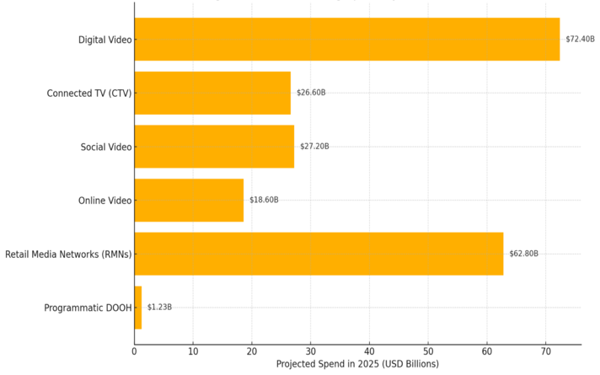
PROGRAMMATIC ADVERTISING SPEND BY CHANNEL (U.S. 2025)
In 2025, 64% of all U.S. advertising dollars are funneled
through programmatic platforms.
Today’s programmatic ecosystem is $220B and growing
Source: BYYD

Slide 6



The programmatic spine of legacy buying systems is bending and about to break because they're held together by rapidly-diminishing consumer IDs.
The rise of AI search is exasperating the flaws of decision making that rely on the harvesting of IDs.
The system is further strained by privacy regulations and walled gardens that lock insights inside closed ecosystems.
IntentKey® is the antidote.
THE AD
SUPPLY
CHAIN IS
UNDER
ASSAULT

Slide 7
PREDICTIVE MEDIA MIX MODELING
Inuvo’s Predictive MMM quantifies the ROI of every marketing channel and external event for smarter budget decisions.
AUDIENCE DISCOVERY
IntentKey understands what people are reading across the web and builds audience models based on real-time content consumption patterns.
IntentKey®'s Versatility
AI-POWERED AD PLACEMENT
When someone matches the audience model, IntentKey instantly activates media to reach them.
INSIGHTS
By analyzing IntentKey signals over time, we uncover insights that shape brand strategy, surface product strengths, and inform creative direction.

Slide 8
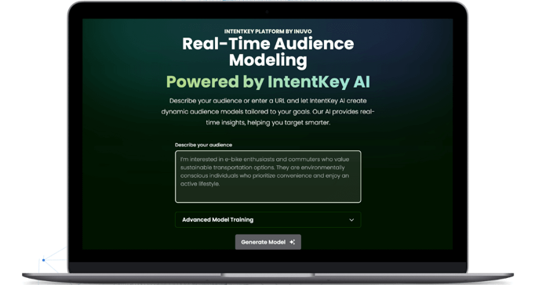
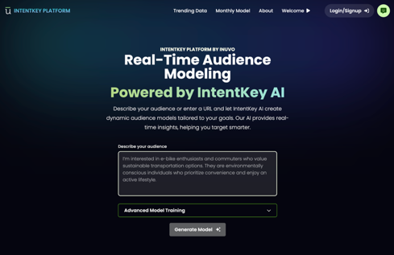
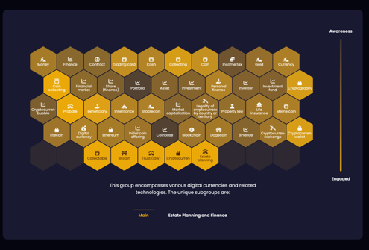
Instantly build audience models
Concepts emerge based on real-time media consumption
Predictive AI audience discovery, identifying prospects before competitors see them
The IntentKey® Platform

Slide 9


Slide 10




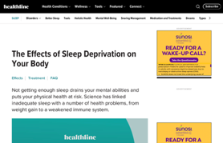





HOW IT
IntentKey® connects with audiences by matching concepts to predictive media consumption.
WORKS
COBRA
Medi-Cal
Open Enrollment
Medicare
AI PLACES CTV AD
Employee Benefits
Dental Coverage
Keep Your Smile Bright with Better Coverage
Affordable Care Act
Pre-Existing Conditions
Enroll Now>
AI PLACES DISPLAY AD
Sample Model Only

Slide 11
OUR
EDGE
FRICTIONLESS ACTIVATION
Activate models through Deal IDs & push to any major DSP, allowing clients and partners to use their existing buying platforms.
PRIVACY-BY-DESIGN Built for today’s internet: no pixels, no cookies, no user IDs — ideal for iOS, VPNs, and private browsing.
PREDICTIVE MODELING
Finds high-intent audiences based on what people are engaging with now — not who they are.
TARGETING LEVERAGE Discover and activate tomorrow’s customers today, up to a full day before your competitors.

Slide 12



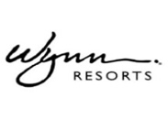






SAMPLING OF CLIENTS SERVED
We consistently surpass client goals by an average of 61% compared to the competition with a 93% client retention rate

Slide 13
OCTOBER 2025 | LD MICRO
NYSE: INUV
NYSE: INUV

Slide 14
REVENUE LEVEL WHERE OPERATING CASH FLOW TURNS POSITIVE
NYSE: INUV
QUARTERLY REVENUE IN MILLIONS
5-year CAGR of 24% through Q2 2025, $2.1M cash, no debt, and a $10M working capital facility

Slide 15
THE GROWTH STRATEGY
PATHWAY TO $100M+
GTM Shift Pursuing upstream budgets, Brand-direct, Self-serve deals
42 new IntentKey total clients added YTD with healthy backlog in Platform business
IntentKey self-serve ramp; 34 active self-serve clients with near-100% gross margin potential
Consultative Sales Predictive Mixed Media Models to CXOs
Favorable market sentiment for privacy-first, AI solutions

Slide 16
OCTOBER 2025 | LD MICRO
NYSE: INUV
Rob Buchner
Chief Operating Officer
ROB.BUCHNER@INUVO.COM

